Slide 1
PREDICTING OPIOID ADDICTION BY ANALYSIS USAGE OF OTHER SUBSTANCES
by
- aashita desai
- abhishek bishnoi
- tarun
- vardaan tyagi

Slide 2



GROUP MEMBERS
Vardaan Tyagi
10419658
Aashita Desai
10412019
Tarun Agarwal
10411197
Abhishek Bishnoi
10416574

Slide 3
Business Goal
Opioid is a drug which is a derivative of Opium, an addictive plant, and is used in several drugs available in market, which is leading to a major epidemic by open opioid abuse.
Opioid abuse is a serious public health issue. Drug overdose deaths are the leading cause of injury death in the United States.
Insurance companies track the usage of Opioid substance to help the fight in Opioid epidemic.
In this experiment we are predicting Opioid substance abuse to help Insurance companies fight for the cause.

Slide 4
Data Mining Goal
Data mining goal is to predict the substance abuse by early prediction of opioid substances such as Cocaine, Heroine etc.
Selecting useful variables by dimension reduction.
With comparatively less predictors.
With high accuracy of prediction.

Slide 5
Data Exploration Goal
Exploring the opioid addicts, non opioid addicts, non addicts and people who are addicts but non-opioids, by different parameters such as
Age
Race
Gender
Income
Education

Slide 6
Data Profile
Data Source: National Household Survey on Drug Abuse, ICPSR, 2004
https://www.icpsr.umich.edu/icpsrweb/ICPSR/series/64/studies/4373?archive=ICPSR&sortBy=7
In this experiment we made use of dataset which comprises of 7224 records, having 603 columns to define each entry.
Out of these 603 columns 40 columns in total have proved to be useful.
Dataset: A total of 6192 rows have been used for training data and the rest 1032 rows have been used for test data.
On an average, 6 columns are used to predict each substance abuse.

Slide 7
Methods
Development of a prediction model with higher accuracy to predict the substance abuse (Alcohol/Marijuana/Heroine/Cocaine).
Multiple linear Regression model used for dimension reduction.
Using KNN and C5.0 prediction model to predict substance abuse.
Analyzing the more accurate prediction model for precision.
Clustering data using K-means Algorithm.

Slide 8
SUMMARY OF DATA USED
ATTRIBUTES | DESCRIPTION
CASE-ID | CASE IDENTIFICATION NUMBER
ALCFIRST | ABOUT HOW LONG AGO WAS FIRST TIME YOU HAD DRINK
ALCDAYS | IN PAST 30 DAYS, HAD DRINK IN HOW MANTY DAYS
ALCFLAG | ALCOHOL EVER USED OR NOT
ALCTRY | AGE WHEN HAD THE FIRST DRINK
ALCYR | ALCOHOL- PAST YEAR USED OR NOT
ADDALC | ADDICTED TO ALCOHOL OR NOT
MJAGE | AGE FIRST TIME PATIENT TRIED MARIJUANA
MJREC | MOST RECENT TIME USED MARIJUANA
MJLIVE | AT THE TIME, AREA LIVING IN
MJTOT | TOTAL TIMES IN LIFETIME USED MARIJUANA
MJKNOWN | EVER KNOWN SOMEONE WHO USED MARIJUANA
MJYR | MARIJUANA PAST YEAR USED OR NOT

Slide 9
ATTRIBUTES | DESCRIPTION
MJDAY30A | PAST 30 DAYS, DAYS USED MARIJUANA
MJFIRST | HOW LONG AGO FIRST TIME TRIED MARIJUANA
MJADD | ADDICTED TO MARIJUANA OR NOT
HER30USE | PAST 30 DAYS, USED HEROINE OR NOT
HERAGE | AGE WHEN TRIED HEROINE FIRST TIME
HERFIRST | HOW LONG AGO, FIRST TIME TRIED HEROIN
HERNEEDLE | WHETHER USED NEEDLE FOR HEROIN
HERREC | MOST RECENT TIME USED HEROIN
HERTOT | TOTAL TIMES IN LIFETIME USED HEROIN
HERADD | ADDICTED TO HEROIN OR NOT
COCAGE | AGE FIRST TIME TRIED COCAIN
COCTOT | TOTAL TIMES IN LIFETIME USED COCAINE
COCUS30A | IN PAST 30 DAYS,DAYS USED COCAINE

Slide 10
ATTRIBUTES | DESCRIPTION
COCREC | MOST RECENT TIME USED COCAINE
ADDCOC | ADDICTED TO ALCOHOL OR NOT
INCOME
AGE | AGE OF RESPONDENT
RAGEGRP | AGE GROUP OF RESPONDENT

Slide 11
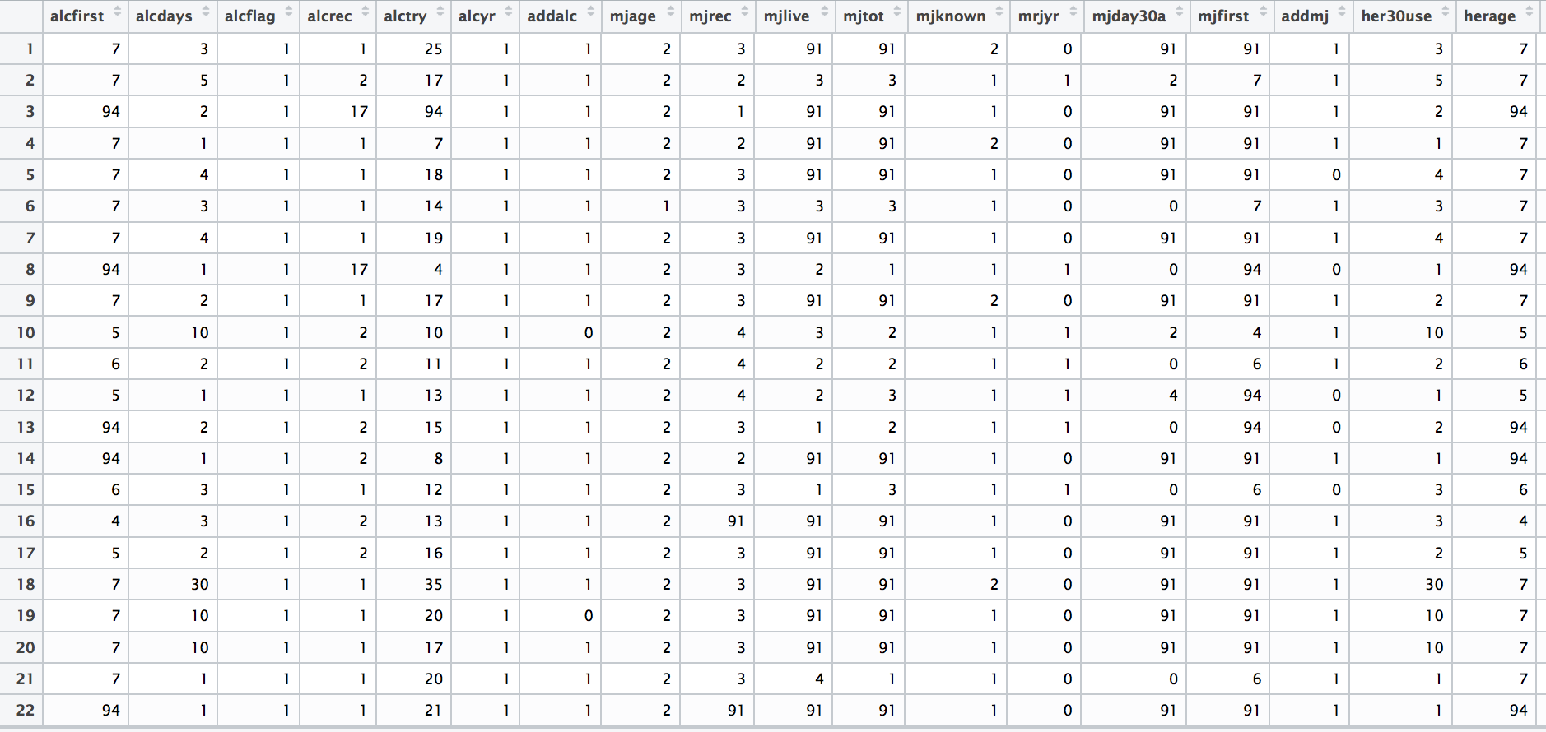
DATA SNAPSHOT

Slide 12
SPLITTING DATA IN TRAINING AND TEST

Slide 13
KNN CLASSIFICATION
In order to predict whether a patient is addicted to Opium or not, we first check for his addiction towards other substances.
The categorization we have used for our model is that
If the patient is addicted to ALCOHOL OR MARIJUANA, HE IS NOT ADDICTED TO OPIUM.
If the patient is addicted to COCAINE OR HEROIN, HE IS ADDICTED TO OPIUM.

Slide 14
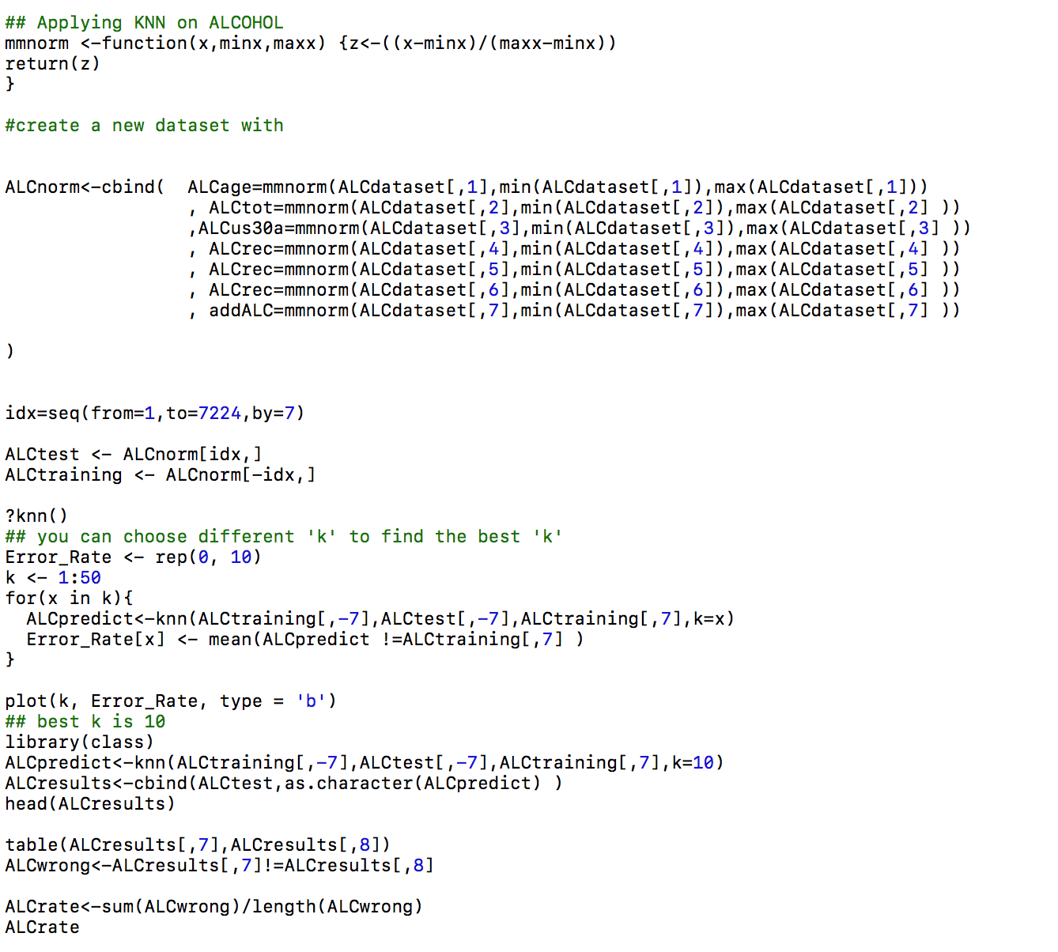
KNN CLASSIFICATION

Slide 15
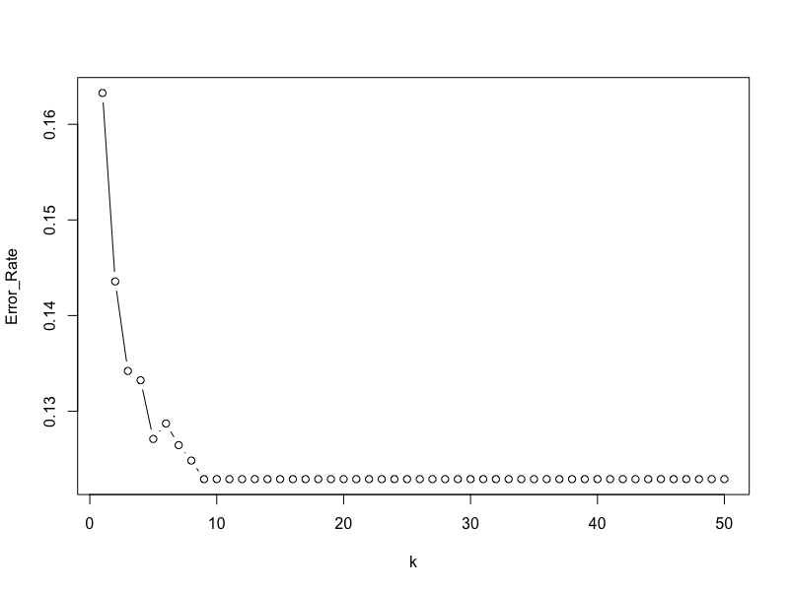
KNN FOR USAGE OF ALCOHOL
PERFORMING KNN CLASSIFICATION FOR FINDING best ”k” TOWARDS ALCOHOL
Best K is 10

Slide 16
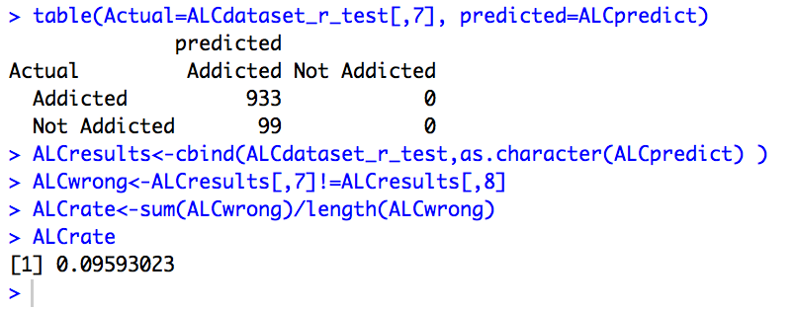
KNN FOR USAGE OF ALCOHOL
PERFORMING KNN CLASSIFICATION FOR FINDING ADDICTION TOWARDS ALCOHOL, WITH K=10.
WE ACHIEVE AN ERROR RATE OF 9.59% FOR OUR DATA MODEL.

Slide 17
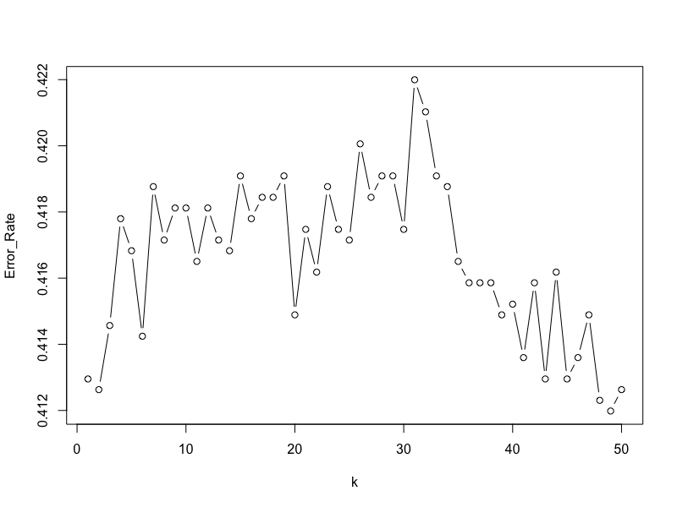
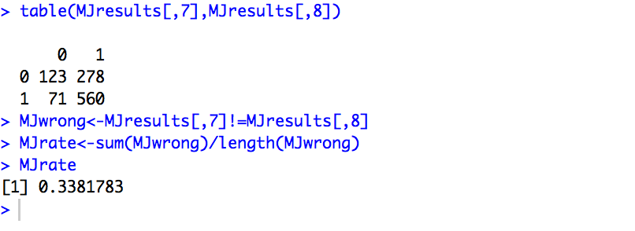
KNN FOR USAGE OF MARIJUANA
PERFORMING KNN CLASSIFICATION FOR FINDING ADDICTION TOWARDS MARIJUANA, WITH K=48.
WE ACHIEVE AN ERROR RATE OF 33.81% FOR OUR DATA MODEL.

Slide 18
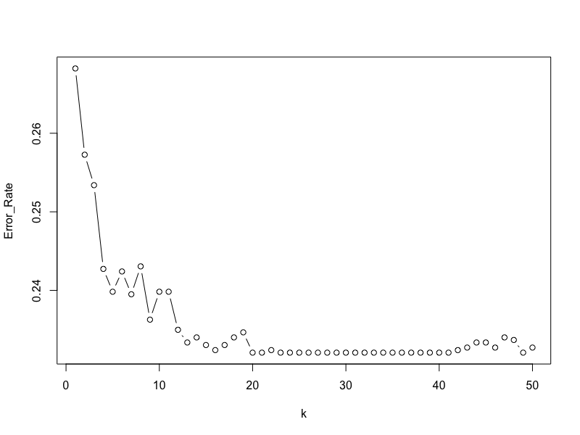
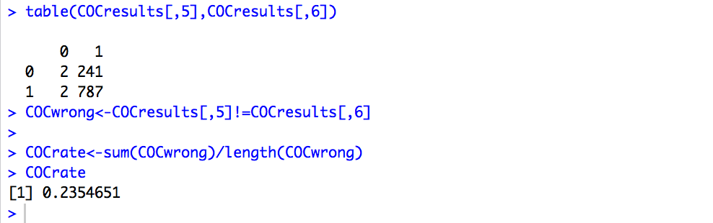
KNN FOR USAGE OF COCAINE
PERFORMING KNN CLASSIFICATION FOR FINDING ADDICTION TOWARDS COCAINE, WITH K=20.
WE ACHIEVE AN ERROR RATE OF 23.54% FOR OUR DATA MODEL.

Slide 19
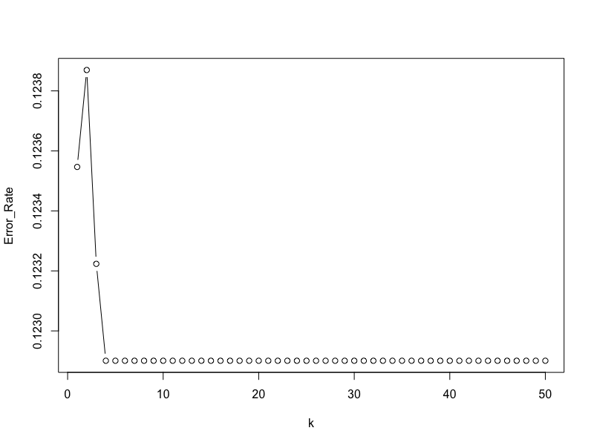
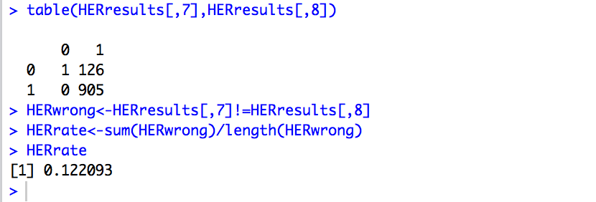
KNN FOR USAGE OF HEROIN
PERFORMING KNN CLASSIFICATION FOR FINDING ADDICTION TOWARDS HEROIN, WITH K=3.
WE ACHIEVE AN ACCURACY RATE OF 12.20% FOR OUR DATA MODEL.

Slide 20
C5.0 CLASSIFICATION
In order to predict whether a patient is addicted to Opium or not, we first check for his addiction towards other substances.
The categorization we have used for our model is that
If the patient is addicted to ALCOHOL OR MARIJUANA, HE IS NOT ADDICTED TO OPIUM.
If the patient is addicted to COCAINE OR HEROIN, HE IS ADDICTED TO OPIUM.

Slide 21
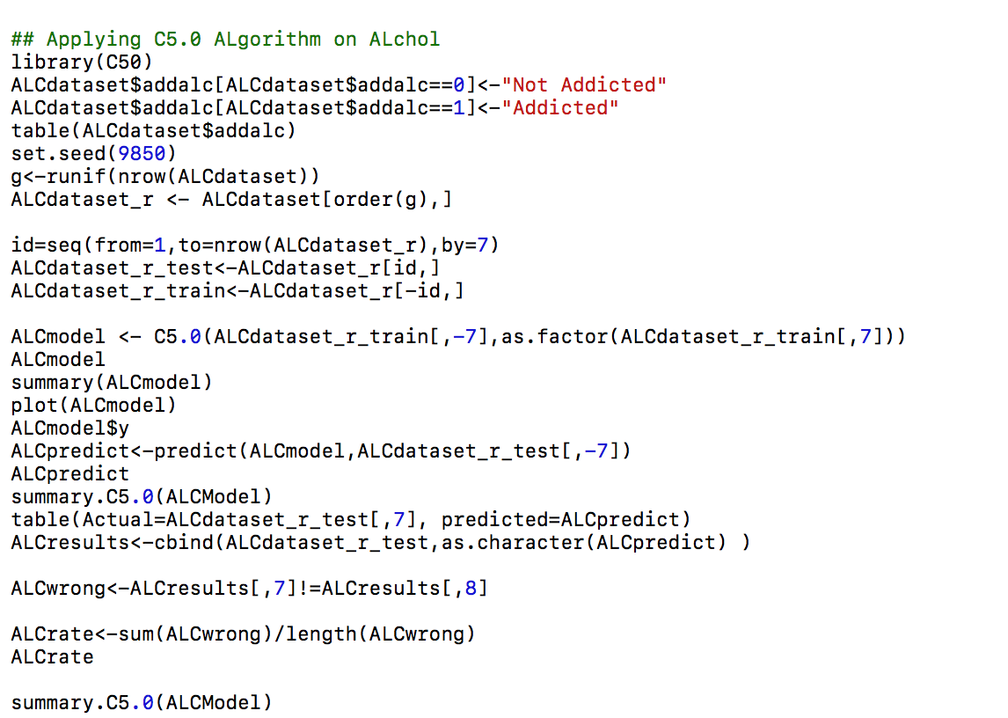
C5.0 FOR USAGE OF ALCOHOL

Slide 22
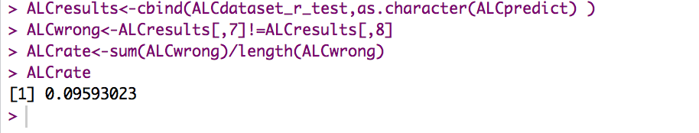
C5.0 FOR USAGE OF ALCOHOL
PERFORMING C5.0 FOR FINDING ADDICTION TOWARDS ALCOHOL.
WE ACHIEVE AN ERROR RATE OF 9% FOR OUR DATA MODEL.

Slide 23
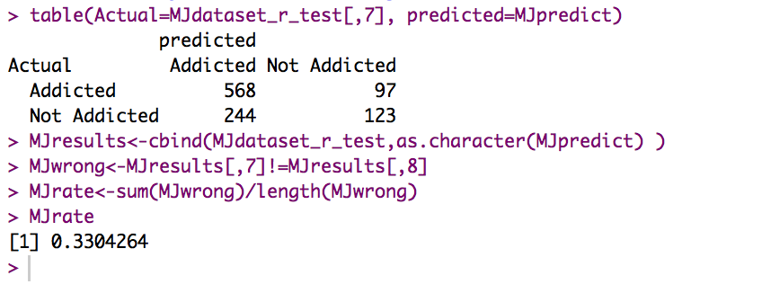
C5.0 FOR USAGE OF MARIJUANA
PERFORMING C5.0 FOR FINDING ADDICTION TOWARDS MARIJUANA.
WE ACHIEVE AN ERROR RATE OF 33% FOR OUR DATA MODEL.

Slide 24
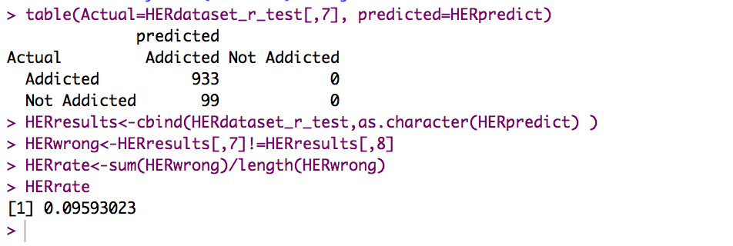
C5.0 FOR USAGE OF HEROINE
PERFORMING C5.0 FOR FINDING ADDICTION TOWARDS HEROIN.
WE ACHIEVE AN ERROR RATE OF 9% FOR OUR DATA MODEL.

Slide 25
Multiple Regression Analysis: Addiction to Alcohol

Slide 26
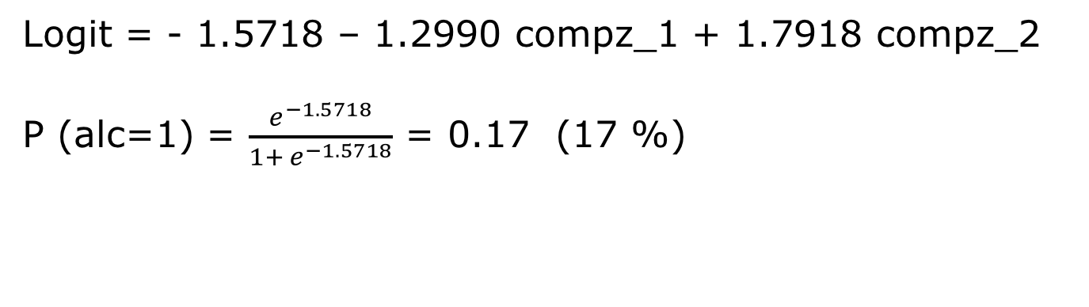
Multiple Logistic Regression Analysis: Addiction to Alcohol Principal Component Analysis
Logit = - 1.5718 – 1.2990 compz_1 + 1.7918 compz_2
P (alc=1) = $\frac{e^{−1.5718}}{1+ e^{−1.5718}}$ = 0.17 (17 %)

Slide 27
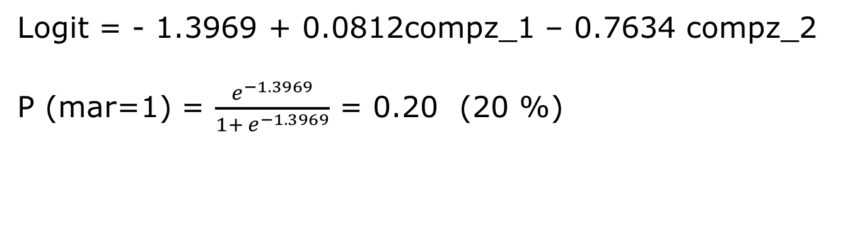
Multiple Regression Analysis: Addiction to Marijuana
Principal Component Analysis
Logit = - 1.3969 + 0.0812compz_1 – 0.7634 compz_2
P (mar=1) = $\frac{e^{−1.3969}}{1+ e^{−1.3969}}$ = 0.20 (20 %)

Slide 28
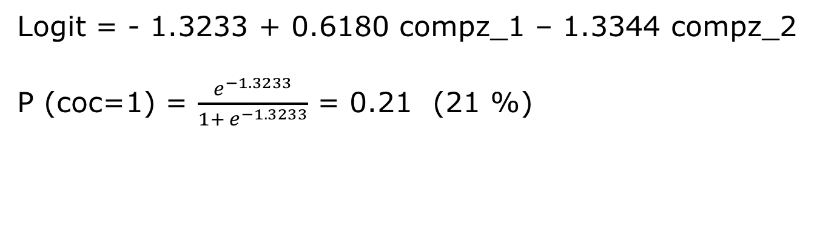
Multiple Regression Analysis: Addiction to Cocaine Principal Component Analysis
Logit = - 1.3233 + 0.6180 compz_1 – 1.3344 compz_2
P (coc=1) = $\frac{e^{−1.3233}}{1+ e^{−1.3233}}$ = 0.21 (21 %)

Slide 29
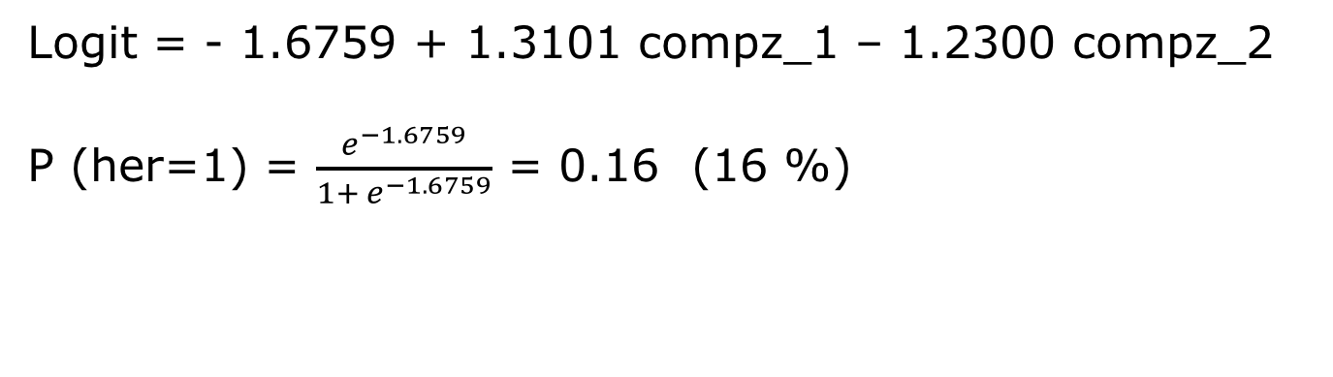
Multiple Regression Analysis: Addiction to Heroine Principal Component Analysis
Logit = - 1.6759 + 1.3101 compz_1 – 1.2300 compz_2
P (her=1) = $\frac{e^{−1.6759}}{1+ e^{−1.6759}}$ = 0.16 (16 %)

Slide 30
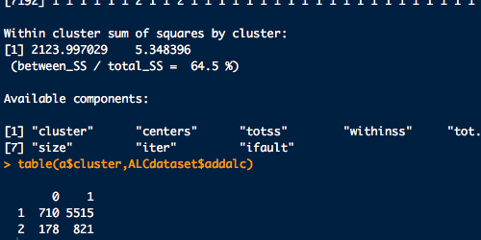
K-Means Clustering Algorithm – Alcohol
PERFORMING K-Means Clustering FOR FINDING ADDICTION TOWARDS ALCOHOL, WITH K=2.

Slide 31
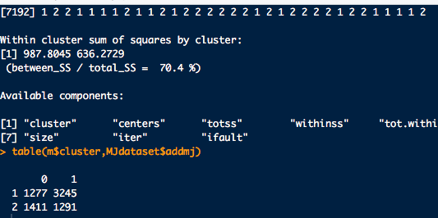
K-Means Clustering Algorithm – Marijuana
PERFORMING K-Means Clustering FOR FINDING ADDICTION TOWARDS MARIJUANA, WITH K=2.

Slide 32
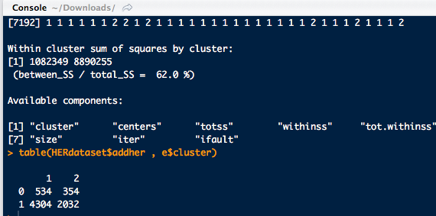
K-Means Clustering Algorithm – Heroin
PERFORMING K-Means Clustering FOR FINDING ADDICTION TOWARDS HEROIN, WITH K=2.

Slide 33
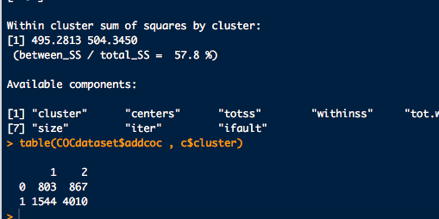
K-Means Clustering Algorithm – Cocaine
PERFORMING K-Means Clustering FOR FINDING ADDICTION TOWARDS COCAINE, WITH K=2.

Slide 34
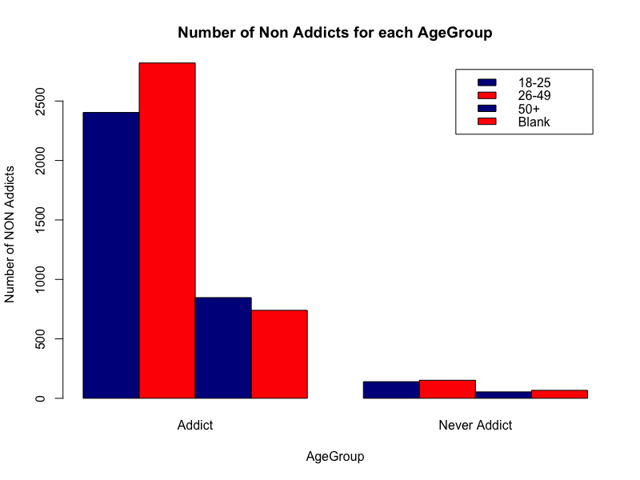

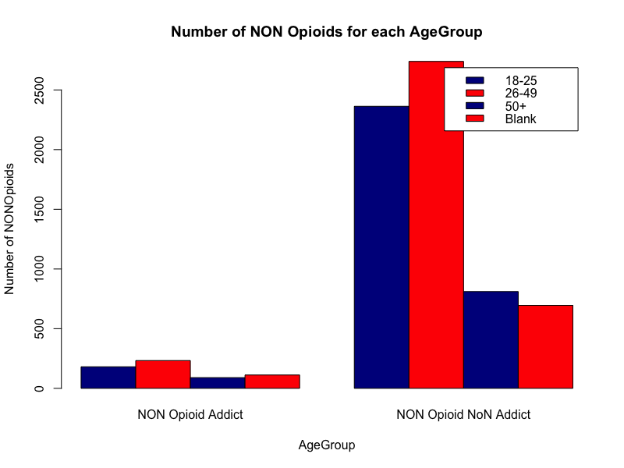
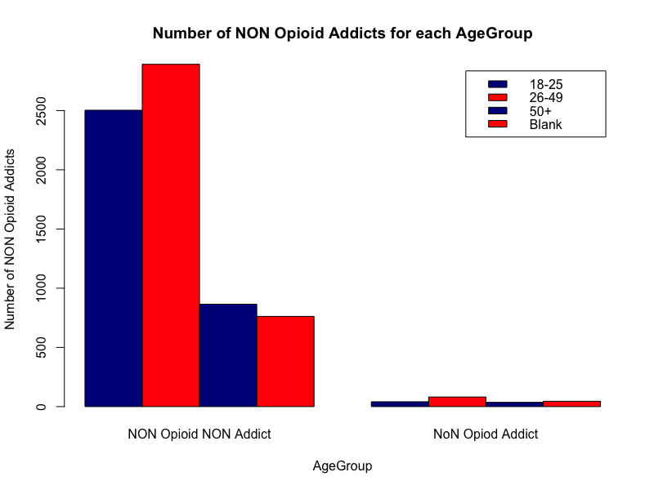
DATA EXPLORATION IN TERMS OF AGE

Slide 35
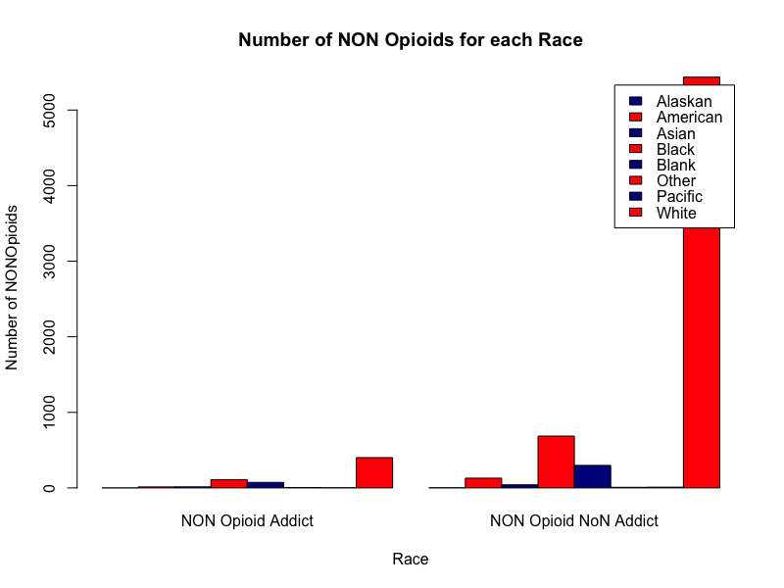
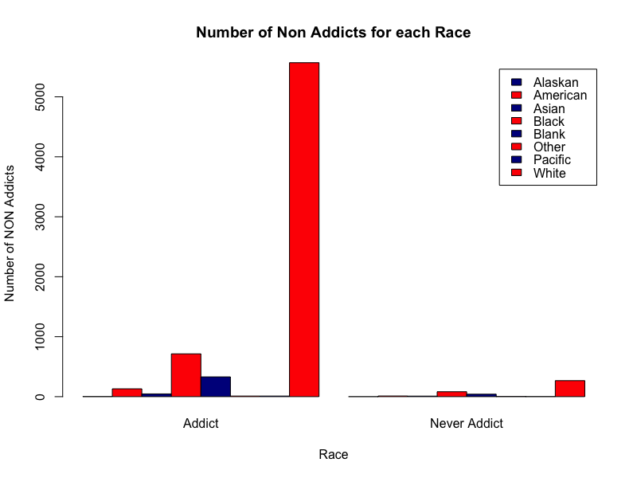

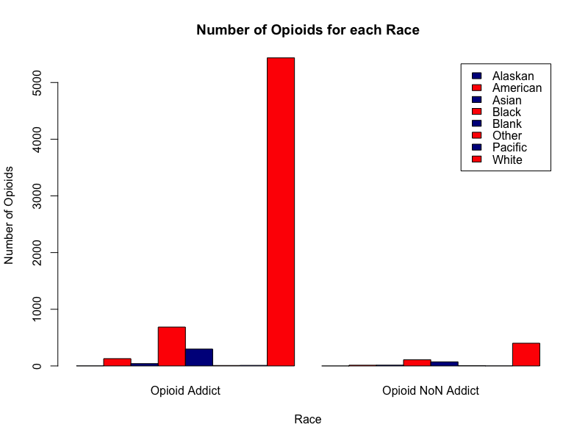
DATA EXPLORATION IN TERMS OF RACE

Slide 36
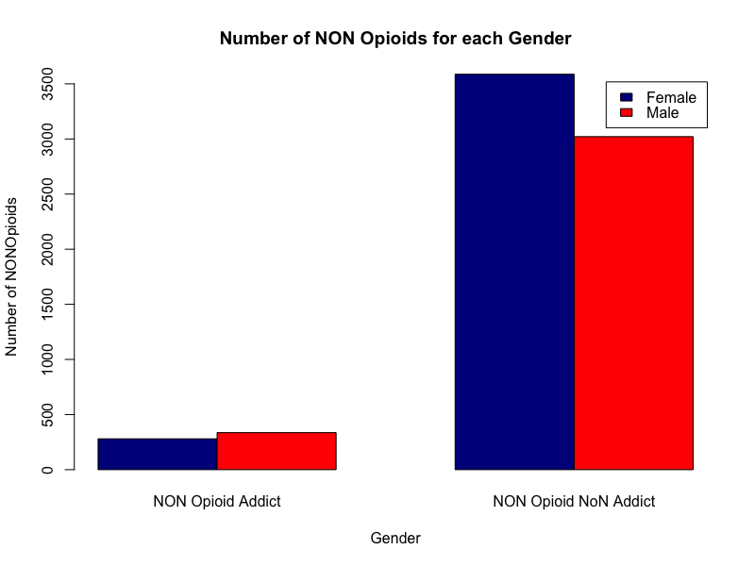
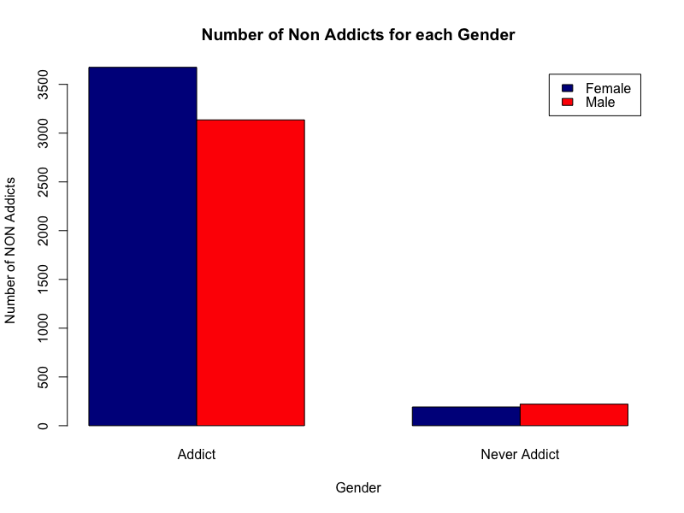
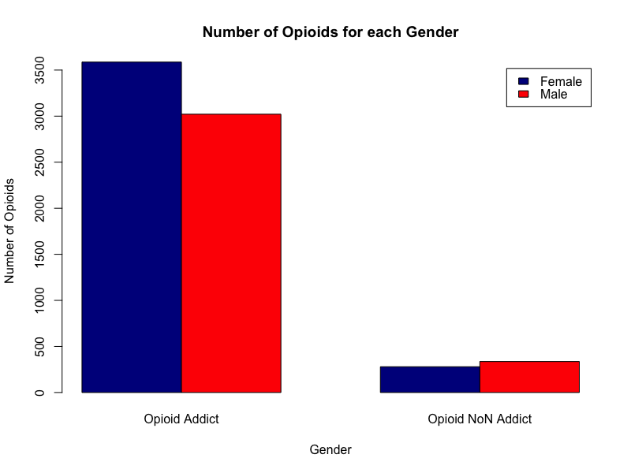
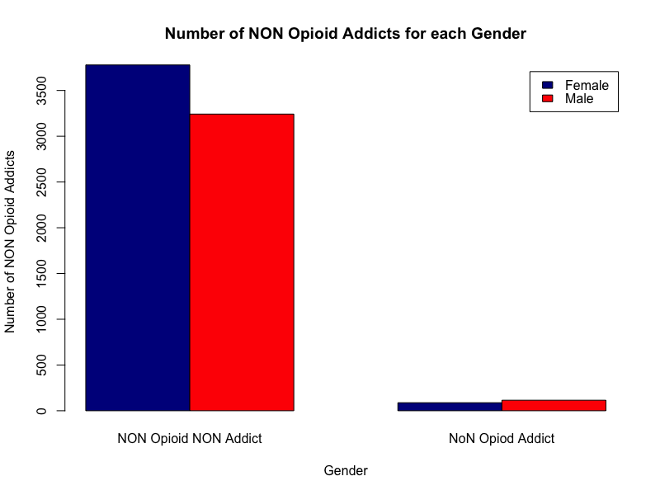
DATA EXPLORATION IN TERMS OF GENDER

Slide 37
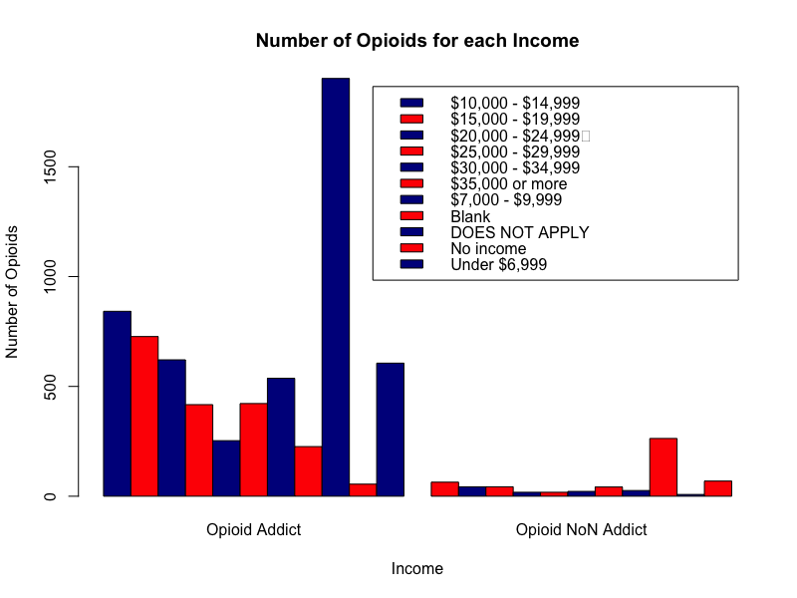
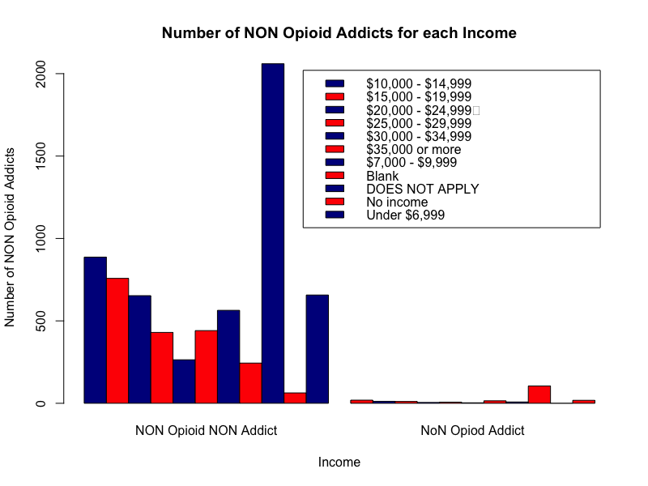
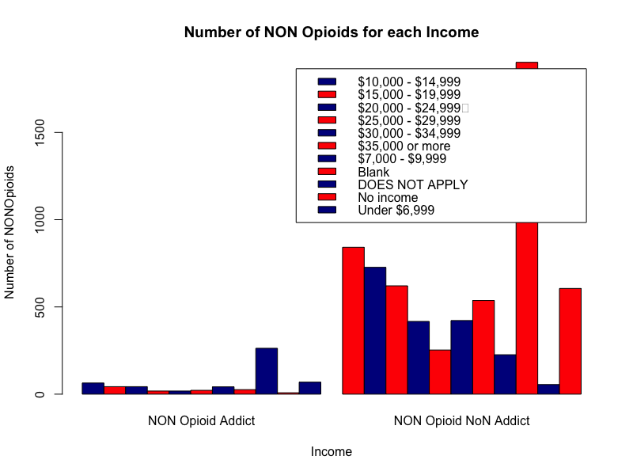
DATA EXPLORATION IN TERMS OF INCOME

Slide 38
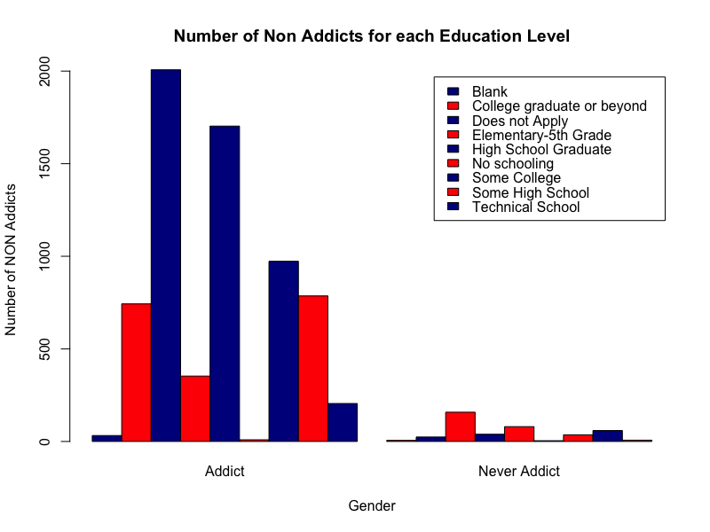
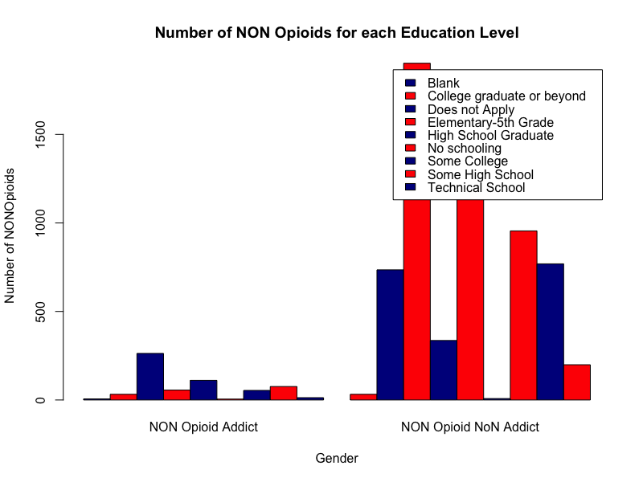
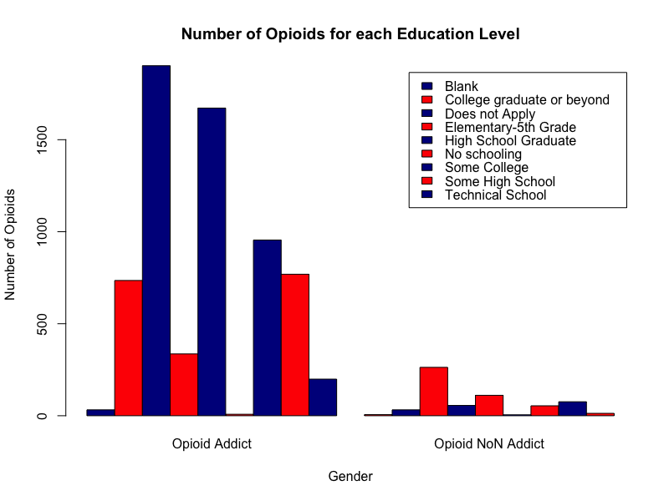
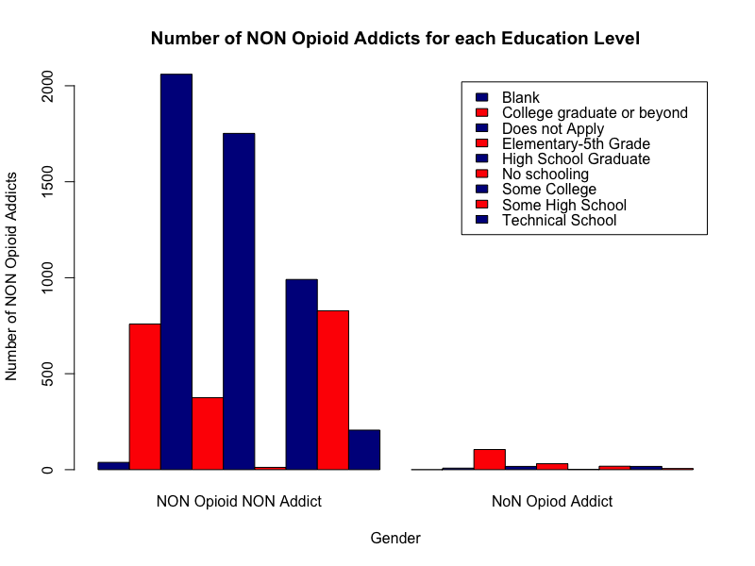
DATA EXPLORATION IN TERMS OF EDUCATION

